Slide 1
That was easy! Creating R packages in minutes with devtools
West Michigan R Users Group
Paul Egeler, M.S.
20 June 2017

Slide 2
Motivation
Why build your own package?

Slide 3
What is a Package?
What does it offer?

Slide 4
What is a Package?
R functions, classes, and other code
Compiled functions
Documentation
Vignettes
Data
Tests

Slide 5
Package Lifecycle
From source code to tools ready to use

Slide 6
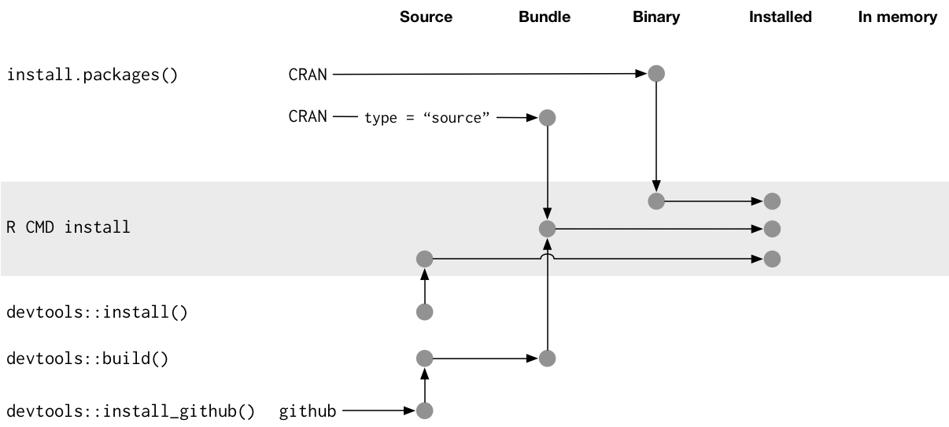
Package Lifecycle
Source -> Bundled -> Binary -> Installed -> In-memory
http://r-pkgs.had.co.nz/diagrams/installation.png

Slide 7
Demonstration
Let’s see it in action!

Slide 8
Questions?
Thanks for watching!

Slide 9
Resources
CRAN: Creating R Packages
https://cran.r-project.org/doc/manuals/R-exts.html#Creating-R-packages
R packages by Hadley Wickham
http://r-pkgs.had.co.nz/intro.html
Hillary Parker
https://hilaryparker.com/2014/04/29/writing-an-r-package-from-scratch/
roxygen2 vignettes
https://cran.r-project.org/web/packages/roxygen2/vignettes/
Cheatsheet
Help > Cheatsheets > Package Development with devtools

